Slide 1
2- TREMATODES or FLUKES
a-MONOGENEAN FLUKES
Monogeneans are a class of parasitic flatworms, which are mainly ectoparasitic on ectothermic/poikilothermic (cold blooded) vertebrates such as amphibians and fish, although the group does have members that infect Crustacea, cephalopods, and mammals but they are rare. In fish, monogeneans are found infecting the skin, gills, buccal cavity and pharynx and only very few are truly endoparasitic. They attach to their host by means of a posterior organ that is usually in the form of two large central hooks surrounded by a corona of 12–16 marginal hooks. This attachment organ is modified considerably in some species and is often useful in identifying different species. Once attached to the host, monogenea feed directly on skin and gill tissue. Two well-known monogenean families have gained justifiable notoriety, the gyrodactylids and the dactylogyrids. The gyrodactylids and the dactylogyrids have confusingly similar names describing two confusingly similar families of parasites. They are usually only differentiated by the simple expedient of being Gyrodactylus spp. if they are on the skin and Dactylogyrus spp. if they are on the gills. Both Gyrodactylus and Dactylogyrus genera conform to the same basic monogenean body shape but they have a substantial and important difference in their mode of reproduction although like all monogeneans they have a simple life cycle involving only one host.

Slide 2
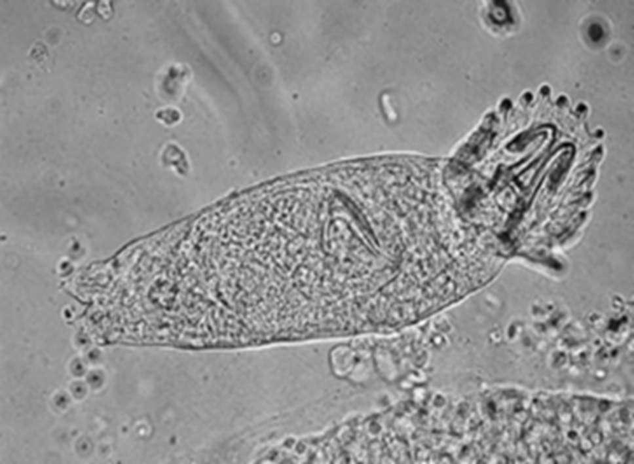

Slide 3
1- Dactylogyrosis
Causes:-Dactylogyrus spp.
D.vastator most dangerous parasite of carp fry, D.extensus serious parasite of carp affecting both fry and older fish. These gill parasites, which have one or two pairs of eye spots, have a complex attachment organ, termed a haptor, consisting of 16 small marginal hooks and two large central hooks. They are oviparous.

Slide 4
Life cycle:- Once the eggs are laid they tend to be borne away from the fish host and hatch into ciliated oncomiracidia, which only have a very short life, e.g. 10–20 hours in which to find a new host. eggs embryonate and hatch in a period which varies greatly with temperature within a species and between species. This is important since in some species, in temperate climates, eggs laid in autumn may overwinter and hatch on the return of favourable conditions in the spring when newly hatched fry of host species are available.

Slide 5
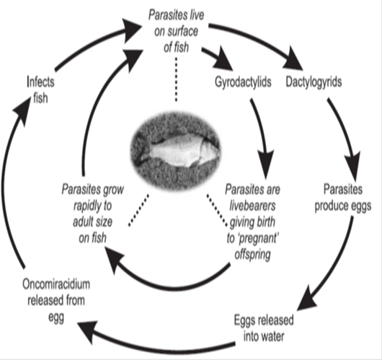
Typical life cycle of monogenean flukes.

Slide 6
Clinical signs:- hyperplasia of the gill epithelium and deformation of the gill lamellae. In young fish this damage can be particularly problematic and results in respiratory failure. fish swim slowly at the water surface or at the water inlet .Adult flukes also cause damage at their attachment sites where necrotic foci form, thus increasing the risk of secondary infections.

Slide 7
Diagnosis:-
1- Clinical signs
2-Lab. Examination.
Control and Treatments:-
a- application of external treatments like
1-Bath of 2.5 % Nacl for 10 Min.
2- Use 1ppm from copper sulfate.
b- or draining and drying infected ponds.

Slide 8
2-Gyrodactylosis
Causes:- Gyrodactylus spp. Like G. cyprini , G. mizellei.
They found on skin, fins and gills. They dont have eye spots, have a complex attachment organ, termed a haptor, consisting of small marginal hooks and two large central hooks. They are viviparous.

Slide 9


Slide 10
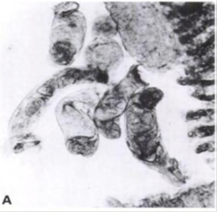

Slide 11
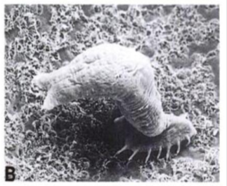

Slide 12
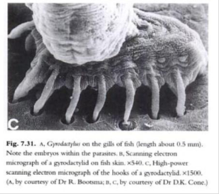

Slide 13
Life cycle:- The Gyrodactylus give birth to live young, which are fully formed at birth and attach directly to the host. The offspring are sexually mature before they are born and can themselves have a fully formed offspring in their uterus prior to birth. Incredibly, this fully formed second embryo can have a third embryo inside and then a fourth embryo inside the third. This means that there can be five generations present in one worm, giving rise to one of its common names, ‘the generation worm’ this gives the parasite a very high reproductive potential.

Slide 14
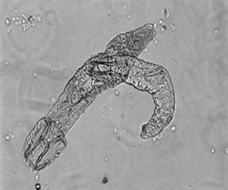

Slide 15
Typical life cycle of monogenean flukes.

Slide 16
Clinical signs:- Heavily infected fish have frayed fins, skin ulcers and damaged gills. Fish turn dark blue in colour, become emaciated and eventually die. The parasite can damage skin at their point of attachment and can form foci for entrance of secondary infections.

Slide 17
Diagnosis:-
1- Clinical signs
2-Lab. Examination.
Control and Treatments:-
a- application of external treatments like
1-Bath of 5 % Nacl for 5 Min.
2- formalin 1:4000 for 25 min. .
b- or draining and drying infected ponds.

Slide 18
b-DIGENEAN FLUKES (TREMATODES)
A class of parasitic flatworms infecting a wide range of different animals. They have a complex life cycle involving at least two hosts. The fish can serve both as the definitive host in which the adult fluke occurs, or as the intermediate host, which usually harbours an encysted life stage. In life cycles that involve fish, an aquatic snail usually serves as the intermediate host, sometimes in addition to a subsequent second intermediate host. Adult digeneans have a characteristic basic body plan, which comprises a dorso-ventrally-flattened body and external suckers used for attachment and feeding. Internally the fluke’s body comprises digestive, reproductive, excretory and nervous systems together with an extensive muscle development.

Slide 19
1-Sanguinicoliasis
(fish as the definitive host)
The Sanguinicolidae contains over 60 species of flukes that occur in the blood system of both marine and freshwater fish. It is those parasite species that infect freshwater fish culture, however, that can cause the most serious economic loss. This loss is not only restricted to cyprinids, as S. klamathensis and S. davisi occur in salmonid farming in North America. In China Sanguinicola lungensis causes high mortalities in cyprinid fish, but on a worldwide basis Sanguinicola inermis is the most problematic. The adult worms are found in the circulatory system of the fish host.

Slide 20
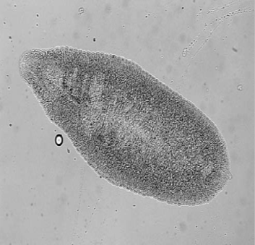
Unstained adult stage of Sanguinicola inermis.

Slide 21
Life cycle:-
Adult fluke , which reside primarily in the heart, are hermaphrodite, i.e. contain both male and female reproductive systems. The adults live for approximately 60 days dependent on temperature, during which time they produce immature eggs, which are released into the fish’s blood system. These triangular-shaped eggs, containing the developing larval stage, the miracidium, accumulate in the capillaries within several organs, e.g. gills, kidney, liver and spleen, and form the site of an intense inflammatory response. Although this response may damage the egg and the enclosed parasite the accompanying degradation of host tissue can be excessive and can result in severe pathological and physiological consequences. Some of the shed eggs become lodged in the capillaries of the gill and are identified in the gill tissue by the presence of the triangular-shaped inclusion and the dark pigmented eyespot of the miracidium. In this location the miracidia mature in 7 days at 20°C and are released from the egg, whereupon they migrate through the gill tissue into the water. Unlike the majority of digenean flukes therefore, eggs of Sanguinicola are not released from the host. The actual release of the hatched miracidium may cause considerable damage to the delicate gill tissue. Released miracidia penetrate the intermediate host, an aquatic snail. Within the snail’s digestive gland the miracidium undergoes a multiplication phase, through two further specialised stages of the parasite, termed the mother and daughter sporocyst. The latter releases numerous cercariae , which are shed from the snail in temperate climates during late afternoon and early evening and penetrate the surface of the fish. If there are a large numbers of cercariae penetrating a single fish then an intense pathological response may be evoked and it has been speculated that it may even cause death in young fish. The cercaria on entering the fish tissue loses its tail and the transformed parasite migrates to the heart and develops into the adult fluke.

Slide 22
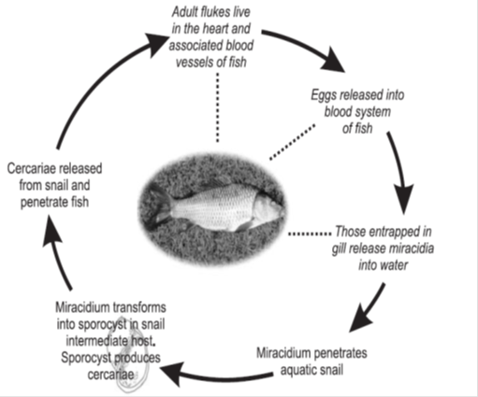
Life cycle of Sanguinicola inermis. Dotted lines and italics indicate stages in which
the fish is involved.

Slide 23
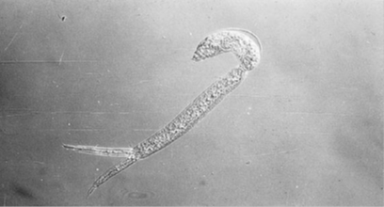
Unstained cercaria of Sanguinicola inermis showing immature fluke (f)and tail (t) used for locomotion by the parasite. Magnifi cation × 200.

Slide 24
Clinical signs:- External signs of initial infection with sanguinicoliasis include lethargy and reluctance to feed . Once infection has become established and parasite burden increases infected fish begin to swim in spiral movements, become emaciated, dark in colour, develop exophthalmia and bulging opercula. Damage to the gills may cause the fish respiratory distress and to spend considerable time at the surface of the water where the oxygen level is greatest. It should be noted, however, that not all infected fish exhibit these symptoms. The penetrating cercariae and/or the entrapped eggs may cause pathology, and possibly death. The latter causes rupture of capillaries, epithelial hyperplasia and haemorrhage in the gills.

Slide 25
Diagnosis:- 1-Diagnosis of the disease is by light microscope examination of the dissected fish. The relatively short-lived adult stage can be located in the heart and, with 400–1000 × magnification, triangular eggs can be observed in the gills and several other organs, e.g. liver.

Slide 26
Control and Treatments:-
1-control is by obtaining fish from disease-free stock.
2- application of anthelmintics (e.g. Praziquantel™) or molluscicides (e.g. copper sulphate ).

Slide 27
2- Diplostomastosis (diplostomiasis or parasitic cataract or eye fluke disease)
(Unencysted larval flukes). (fish as an intermediate host)
Diplostomum and the related eye flukes are ubiquitous parasites occurring in a range of fish species. Diplostomum represents one of the most common parasites in freshwater fish and can become well established in a fish population within two years of introduction.

Slide 28
Life cycle:- The parasite on which most of the research studies have been carried out is Diplostomum spathaceum. This, like all the eye flukes, has a three host life cycle, two of which are aquatic. The adult flukes inhabit the small intestine of the definitive host, piscivorous birds usually members of the gull family (Laridae). When the bird consumes an infected fish the metacercaria is released from the fish tissue, becomes activated by the bile salts and establishes in the bird’s intestine. Sexual development can be completed in three days and eggs are produced for 3–5 months. These eggs are passed out in the bird’s faeces into water and release the free-living, short-lived miracidia, which locate and penetrate the snail, the first intermediate host. Within the snail the mother and daughter sporocysts are formed that produce cercariae, which are shed into the water. These locate and penetrate the fish possibly via the gills, buccal mucosa or eyes and are transformed into the ‘diplostomule’. This migrates by an unknown route to the lens of the eye where it develops for 8 weeks before it is infective. Several species of fish including many cyprinids can serve as a second intermediate host, e.g. roach, common minnow, carp, goldfish, bream, rudd, gudgeon, bleak.

Slide 29
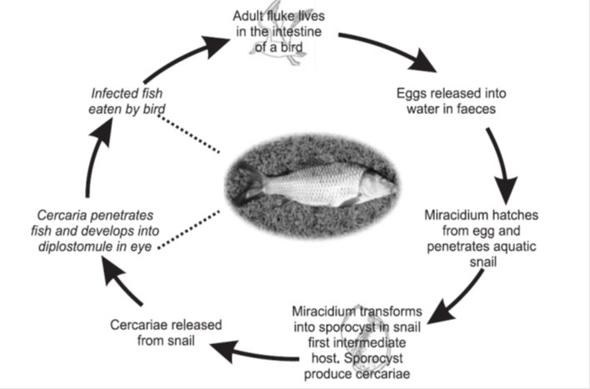
Life cycle of Diplostomum sp. Dotted lines and italics indicate stages in which the fish is involved.

Slide 30
Clinical signs:- In carp fry an infection rate of over 3 cercaria/fish has been shown to be lethal. Parasites in the eye cause blindness by cataracts and lens dislocation or induce an exophthalmic response. Blindness reduces food intake and increases the chance of predation and therefore progression into the definitive host.

Slide 31
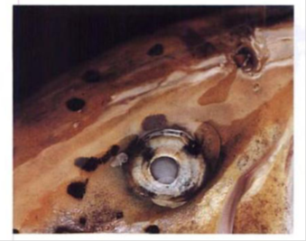

Slide 32
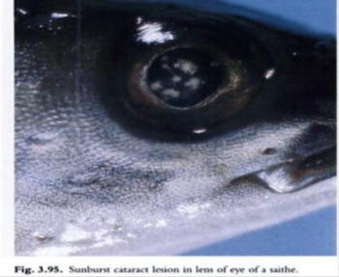

Slide 33
Diffrential diagnosis:- 1-nutritional deficiencies
Diagnosis:- 1- Clinical signs 2-Lab.examination
Control and Treatments:- 1- Infection can be reduced by creating turbulent water, which reduces the chances of the cercaria finding a fish, or by treating the pond with molluscicides or introducing molluscivorous fish such as tench or bream.
2- Infected fish can be treated with Praziquantel .

Slide 34
3- Black spot disease
(Encysted larval flukes) (fish as an intermediate host)
This is a common term given to any larval digenean that on infecting a fish becomes encapsulated in the surface layers of the host and evokes a host response resulting in an accumulation of melanin. This pathological melanisation results in the formation of a black spot, hence the name of the disease . This pathological response can be stimulated by several species of fluke, e.g. Posthodiplostomum cuticola (syn. Neasus cuticola), Apophallus sp. and can occur in many cyprinid species, including wild or farm-reared aquarium cyprinids.

Slide 35
Life cycle:- Posthodiplostomum cuticola is widely distributed and in Europe over 50 fish species are thought to be potential hosts. These include cyprinids such as common carp, bream, rudd and roach . Cercariae are liberated from a snail first intermediate host, Planorbis spp. And locate and invade the skin of the fish. The invading larvae encyst in the host and the black spots develop within 33 days of infection at a temperature of 22°C. Herons usually serve as the definitive host. When the fish is eaten by the definitive host, a piscivorous bird, the digestive process releases the encysted metacercaria, which then attaches to the host’s gut wall. Predation by the definitive host is probably dramatically increased by the greater visibility of a fish covered in black spots

Slide 36
Clinical signs:- presence of the dark areas on the surface of the fish. Dark cysts have a diameter of 0.69–0.99 mm and contain a metacercaria that lacks suckers. The cysts that form can be quite pathogenic and affect the normal tissue functioning particularly if they are located in sensitive areas, e.g. the gills.
Diagnosis:- 1- Clinical signs 2- Lab.examination( Examination of the enclosed metacercaria is required to establish the causative organism).
Control and Treatments:- control measures usually entail obtaining disease-free stock of fish or elimination of snail intermediate hosts.

